Slide 1
Machine Learning using R
Intensive
Class 1

Slide 2
Introduction
Your name and current profession
Why did you enroll in the course
What is your expectation at the end of the course
How familiar are you with R

Slide 3
Course Objectives
R Basics
Data Collection, Input and Output
Data Exploration, Data Visualization and Data Manipulation
Introduction to Machine Learning
Machine Learning Project

Slide 4
Course Reading
^{Mandatory} Machine Learning with R by Brett Lantz © 2015 Packt Publishing 2nd edition
^{Optional} R for Everyone: Advanced Analytics and Graphics (Addison-Wesley Data & Analytics Series) by Jared Lander © 2013 Addison-Wesley Professional 1st edition

Slide 5
R and RStudio
R and RStudio are free and open-source.
R and RStudio can be installed on most operating systems like Windows, Mac OS X, Linux.

Slide 6
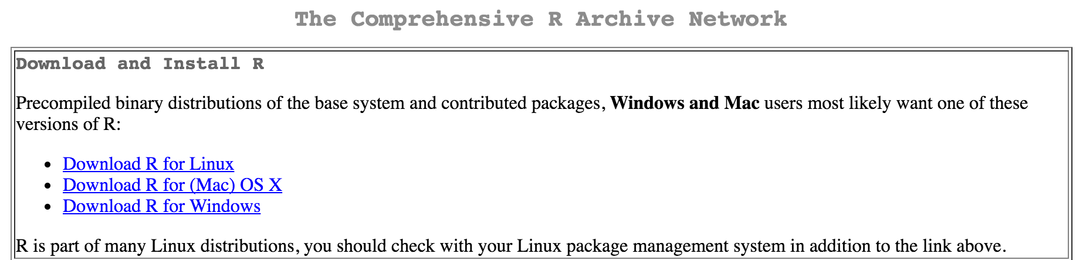
Installing R
Go to The Comprehensive R Archive Networkhttps://cran.r-project.org/

Slide 7
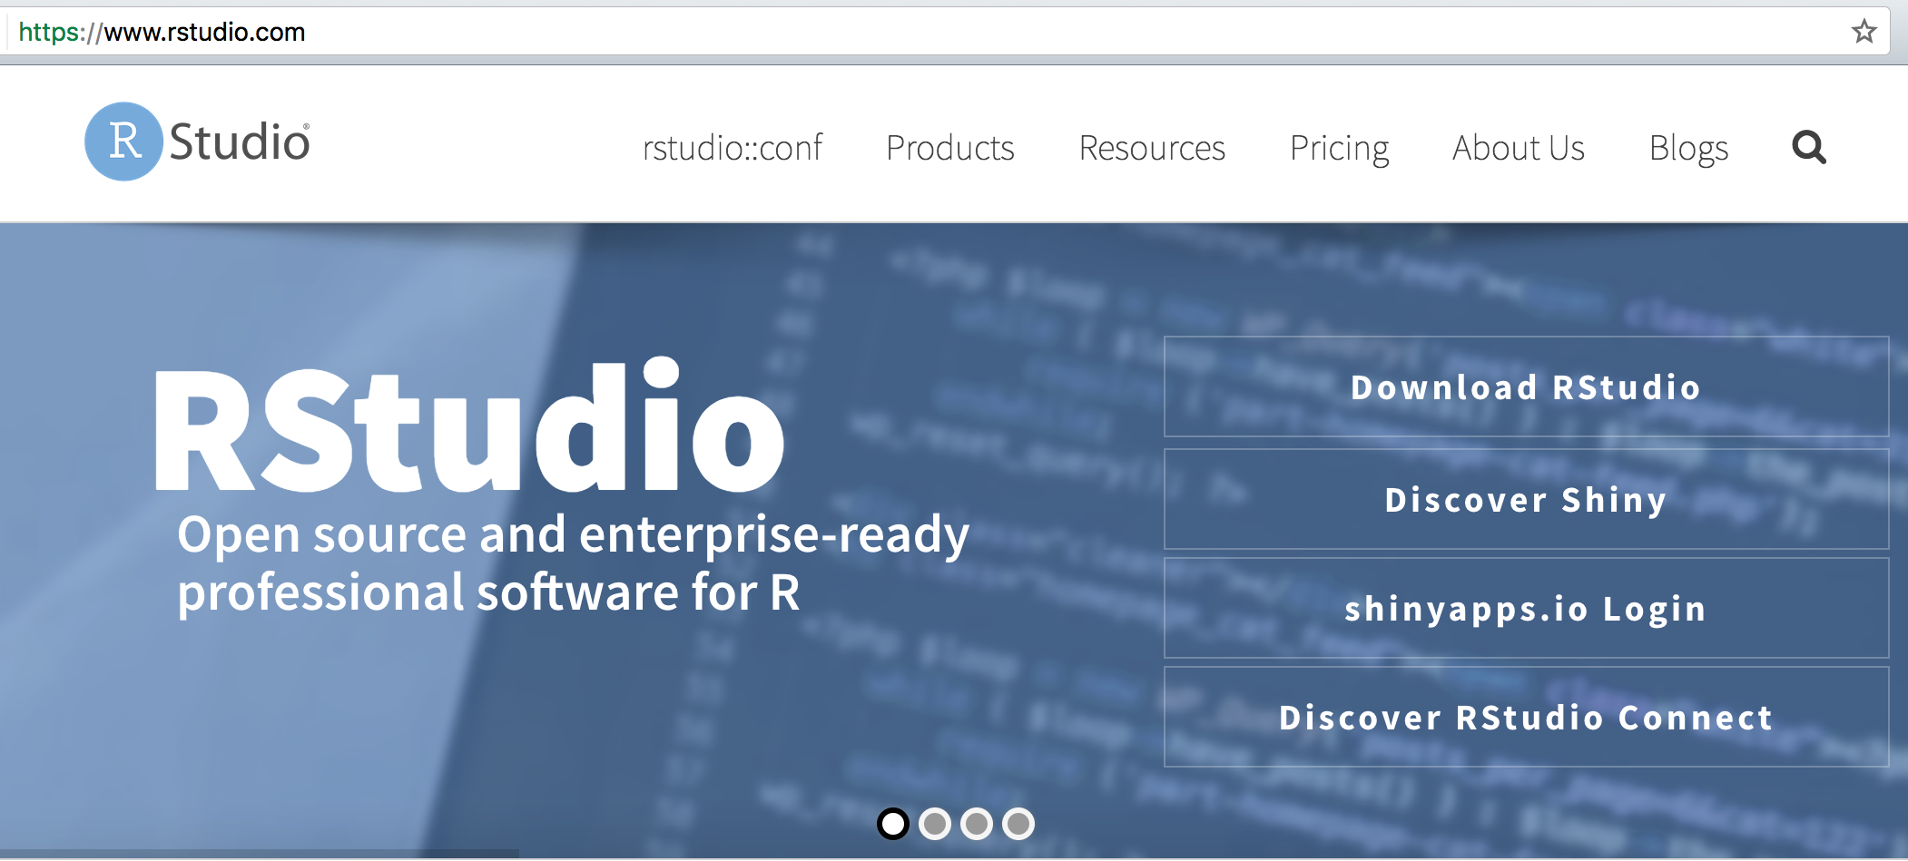
Installing RStudio
Go to RStudio website https://www.rstudio.com/
Select Download RStudio
Download RStudio Desktop

Slide 8
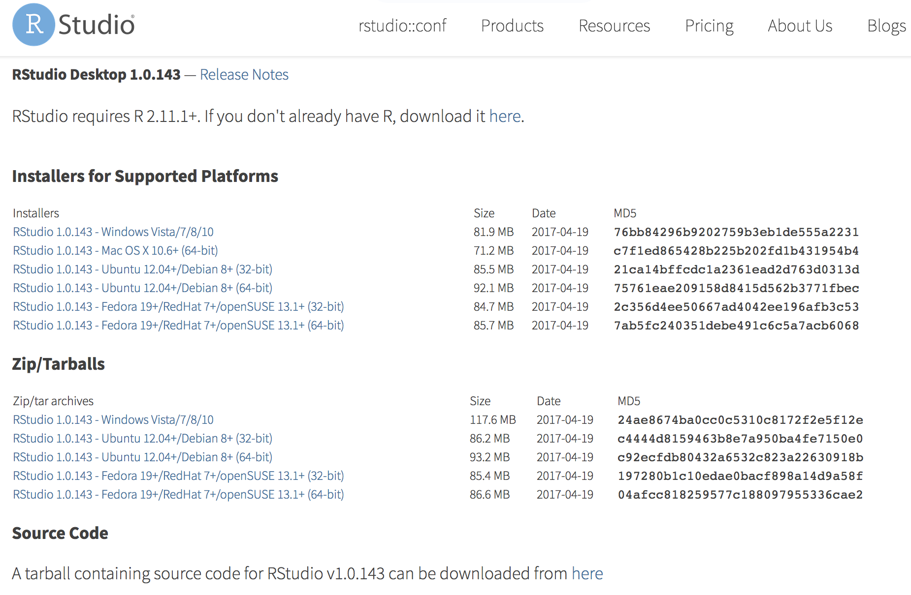
Installing RStudio

Slide 9
R Basics
Get help on a particular function: ?mean
Search help files for a word or phrase: help.search (‘weighted mean’)
Install package: install.packages(‘datasets’)
Load the package into the session:library(datasets)
Load a built-in dataset: data(iris)
Get summary of object: summary(iris)
Get summary of object’s structure: str(iris)
View first 6 rows of data: head(iris)
View last 6 rows of data: tail(iris)
Find the class of an object: class(iris)

Slide 10
R Basics
Fundamental structure in R is called a Vector
Vector are made of of Elements
Vector requires all Elements to be the same type
Vector Types:
Integer (numbers without decimals)
Numeric (numbers with decimals)
Character (text data)
Logical (TRUE or FALSE values)
Special values within a vector
NA (missing value)
Null (absence of a value)

Slide 11
R Basics
Join elements into a vector using combine: c(1,3,5)
Vector with integer sequence: 1:5
Vector with complex sequence: seq(1,5, by=0.5)
Repeating a vector: rep(1:5, times = 3)
Repeating elements of a vector: rep(1:5, each= 3)
Vector can be assigned a name using <- operator:
x<- rep(1:5, times = 3)
Return sorted values of x: sort(x)
Return reversed values of x: rev(x)
See counts of values: table(x)
See unique values: unique(x)

Slide 12
R Basics
Categories of value for data are know as Nominal.
Factor is a special vector that is used for representing nominal variables.
blood<-factor(c(“A”, “B”, “AB”))
blood<-factor(c(“A”, “B”, “AB”), levels = c(“A”, “B”, “AB”, “O”))

Slide 13
R Basics
List is used for storing an ordered set of values and allows different types of values to be collected.
List are special type of vector.
person1<-list (name = “Person1”, blood = “A”, gender = “MALE”)
Question:
Can you correct the list so that blood has categories for A, B, AB and O and gender has categories for MALE and FEMALE?

Slide 14
R Basics
Answer:
Can you correct the list so that blood has categories for A, B, AB and O and gender has categories for MALE and FEMALE?
person1<-list(name="Person1", blood=factor("AB",levels=c("A", "B", "AB", "O")), gender=factor("MALE", levels=c("MALE", "FEMALE")))

Slide 15
R Basics
Selecting vector Elements
Select 2nd element: person1[2]
Select all but 2nd element:person1[-2]
Select elements 1 to 2: person1[1:2]
Select all but elements 1 to 2: person1[-(1:2)]
Select element by name: person1[‘name’]
Select elements 1 and 3: person1[c(1,3)]
By value: x[x == 3]
All elements greater than 3: x[x > 3]
Elements in set 1, 2 and 5: x[x %in% c(1, 2, 5)]

Slide 16
R Basics
Conditional operators
Are equal: a == b
Not equal: a != b
Greater than: a > b
Greater than or equal to: a >= b
Less than: a < b
Less than or equal to: a <= b
Is missing: is.na(a)
Is null: is.null(a)

Slide 17
R Basics: Data Frame
Data frame is the most important data structure used in Machine Learning.
It is analogous to spreadsheet or database.
It is a List of Vectors.

Slide 18
R Basics: Data Frame
Question:
Create the following vectors:
Vector: student = A, B, C, D, E, F
Factor: english = PASS, FAIL, PASS, PASS, FAIL, PASS
Factor: maths = PASS, FAIL, PASS, FAIL, PASS, PASS
Factor: gender = FEMALE, FEMALE, MALE, MALE, MALE, FEMALE
Vector: rank = 2, 6, 3, 5, 4, 1
Create a data frame called ourclass with the above data
HINT: dataframe_name <- data.frame (vector1, vector2….., stringsAsFactors = FALSE)

Slide 19
R Basics: Data Frame
Extract entire column: ourclass$student
Extract multiple columns: ourclass[c(“student”,”rank”)]
Extract specific column: vector[row, column]
ourclass[2,1]
ourclass[2,1:5]
ourclass[2, ]
ourclass[,1]
Question:
Can you tell me another way to retrieve ourclass[c(“student”,”rank”)] information?

Slide 20
R Basics: Data Frame
Question:
Can you tell me another way to retrieve ourclass[c(“student”,”rank”)] information?
Best: ourclass[,c(1,5)]
Also: ourclass[1:6,c(1,5)]

Slide 21
R Cheat Sheets
https://cran.r-project.org/doc/contrib/Short-refcard.pdf

Slide 22
Contact Information
Email: surbhiraj18@gmail.com

